Slide 1
CIS 321 Project Presentation Project topic - Business data analysis tool
S22212571 CHAN CHUN KIT
S22212852 CHEUNG SIU CHUN

Slide 2
Business data analysis tool
Application Features:
Users can input business data such as sales, revenue, and expenses and analyze the data using statistical methods.
Users can create graphical representations of the data such as line charts, bar charts, and scatterplots.
Users can perform regression analysis to identify correlations between different variables.

Slide 3
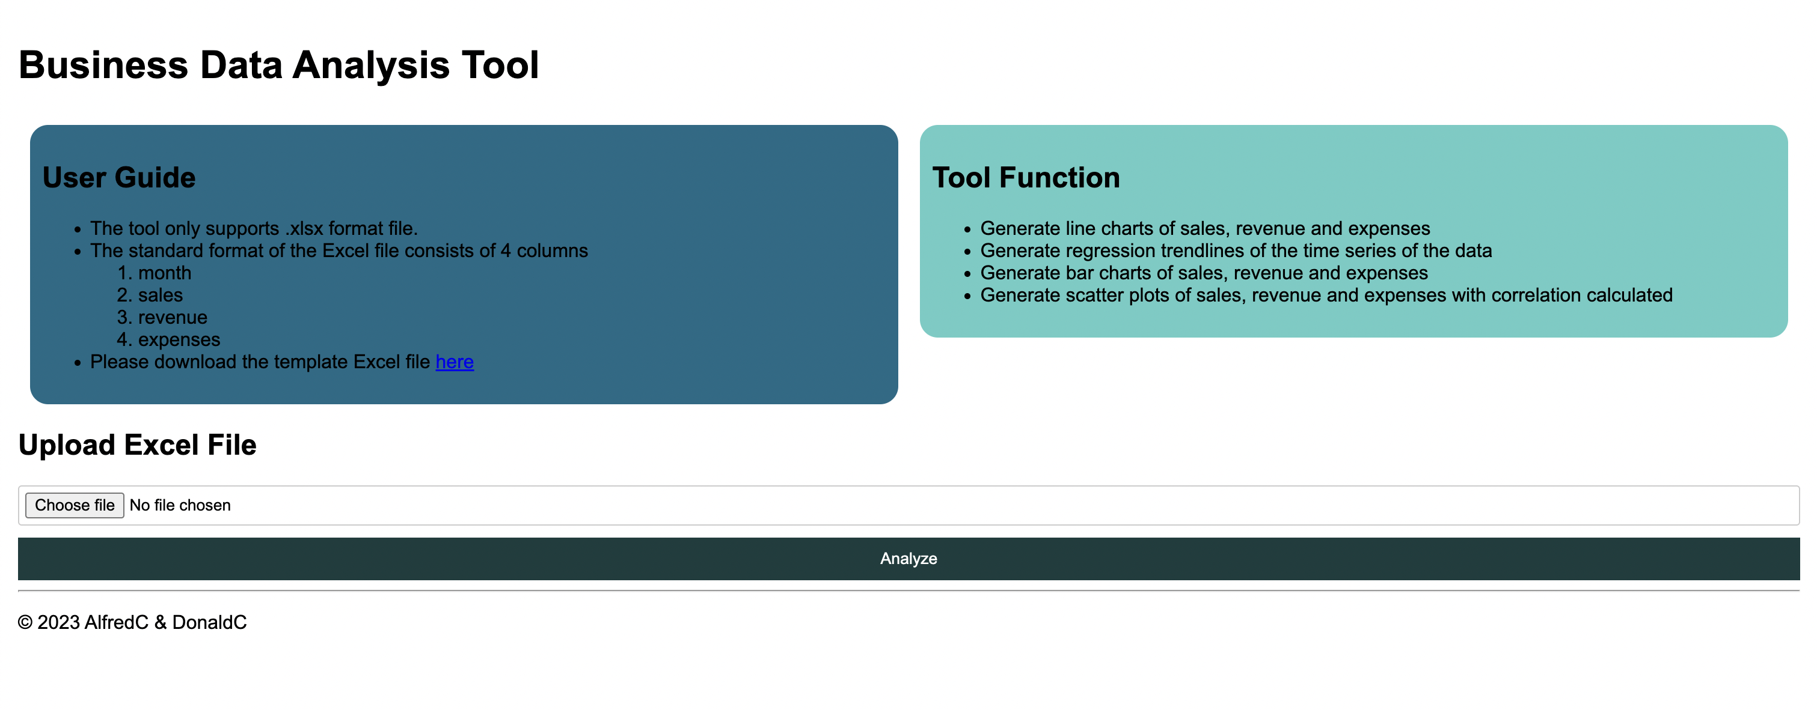
Application HTML Webpage

Slide 4
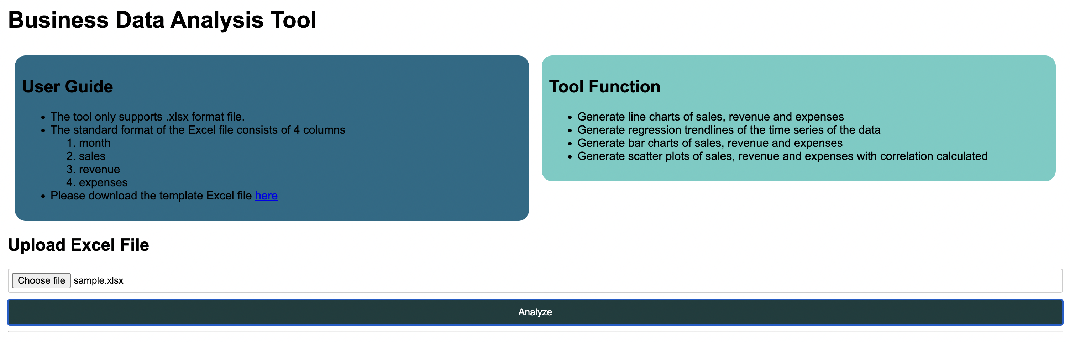
Application Features - upload data by excel
input business data by uploading excel file by excel to html library :<script src="https://cdnjs.cloudflare.com/ajax/libs/xlsx/0.17.0/xlsx.full.min.js"></script>

Slide 5
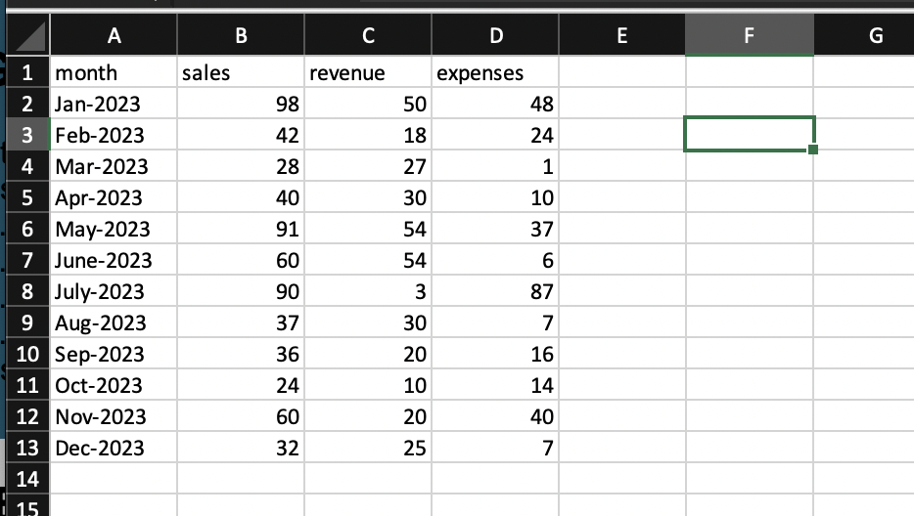
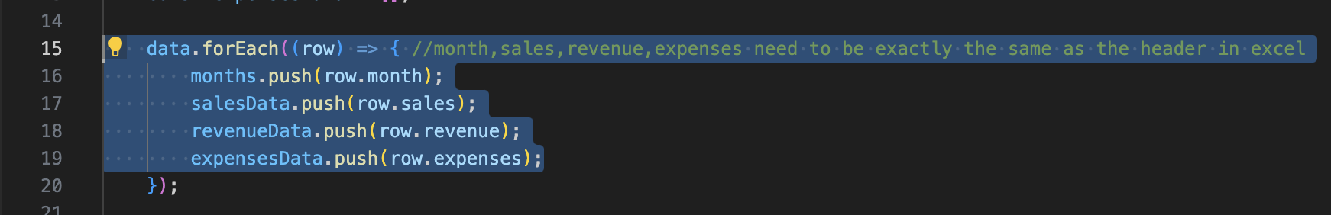
excel file format

Slide 6
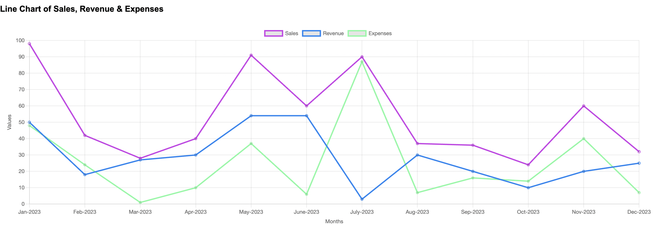
Demo of application – line chart

Slide 7
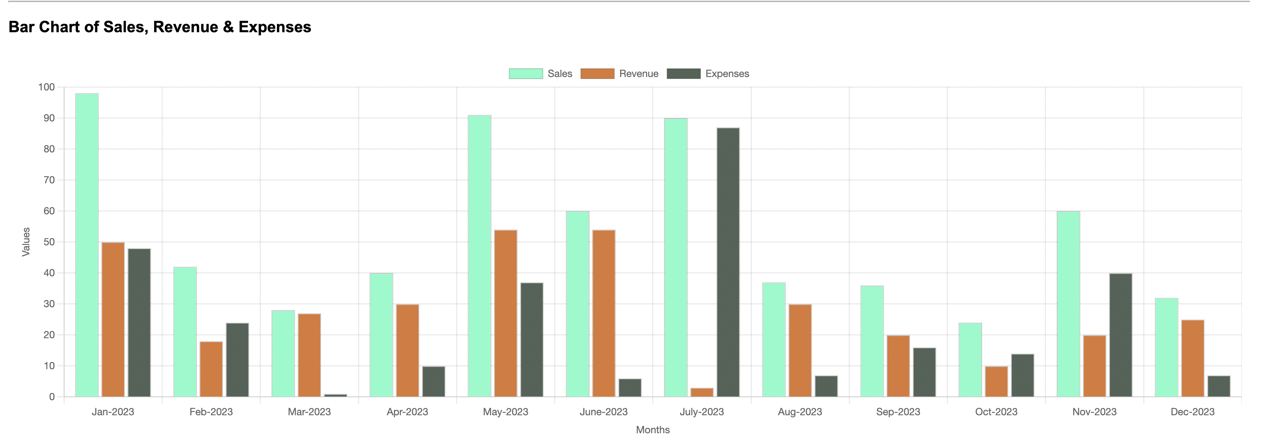
Demo of application – bar chart

Slide 8
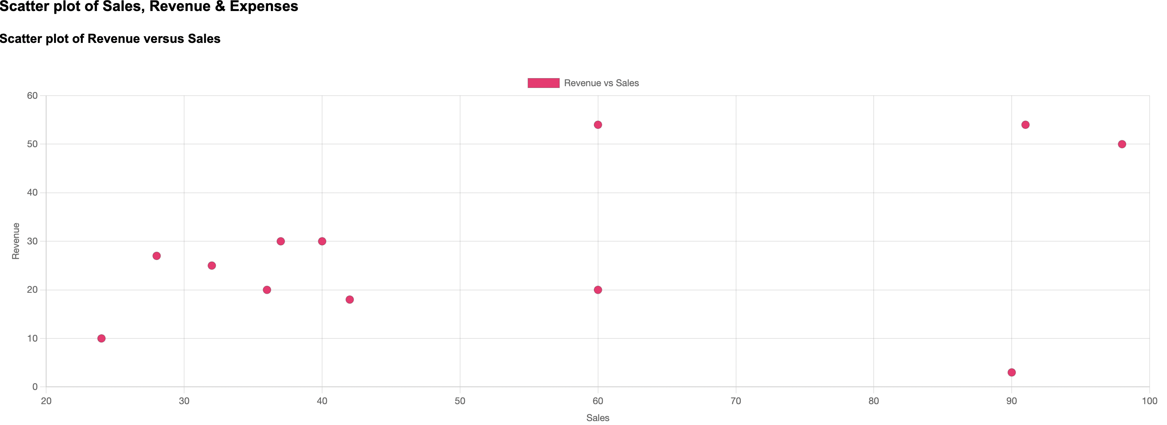
Demo of application – Scatter plot Revenue versus Sales

Slide 9
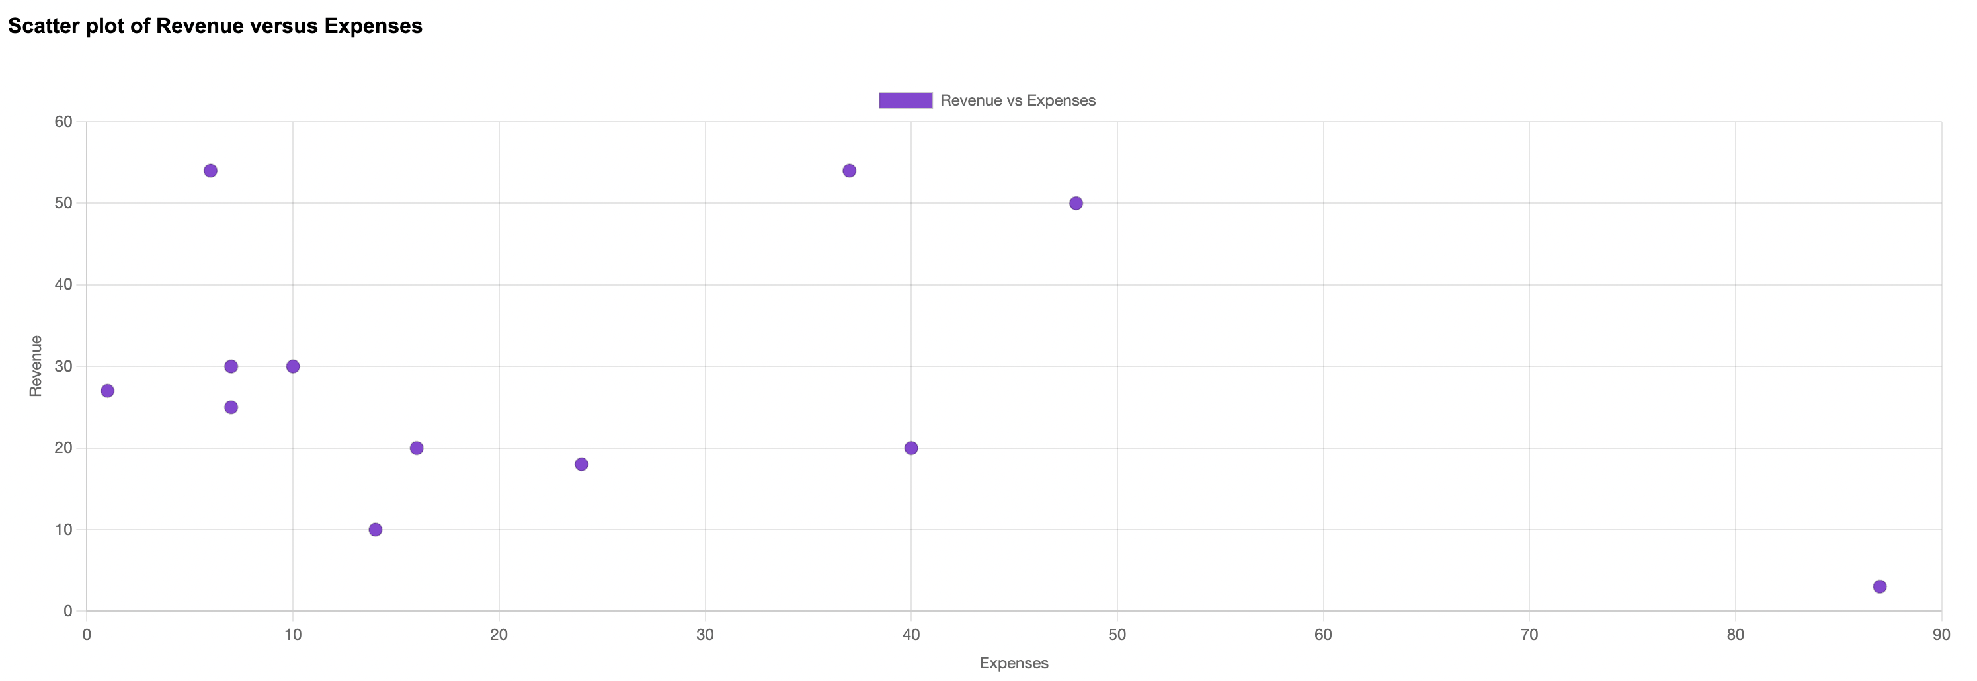
Demo of application – Scatter plot Revenue versus Expenses

Slide 10
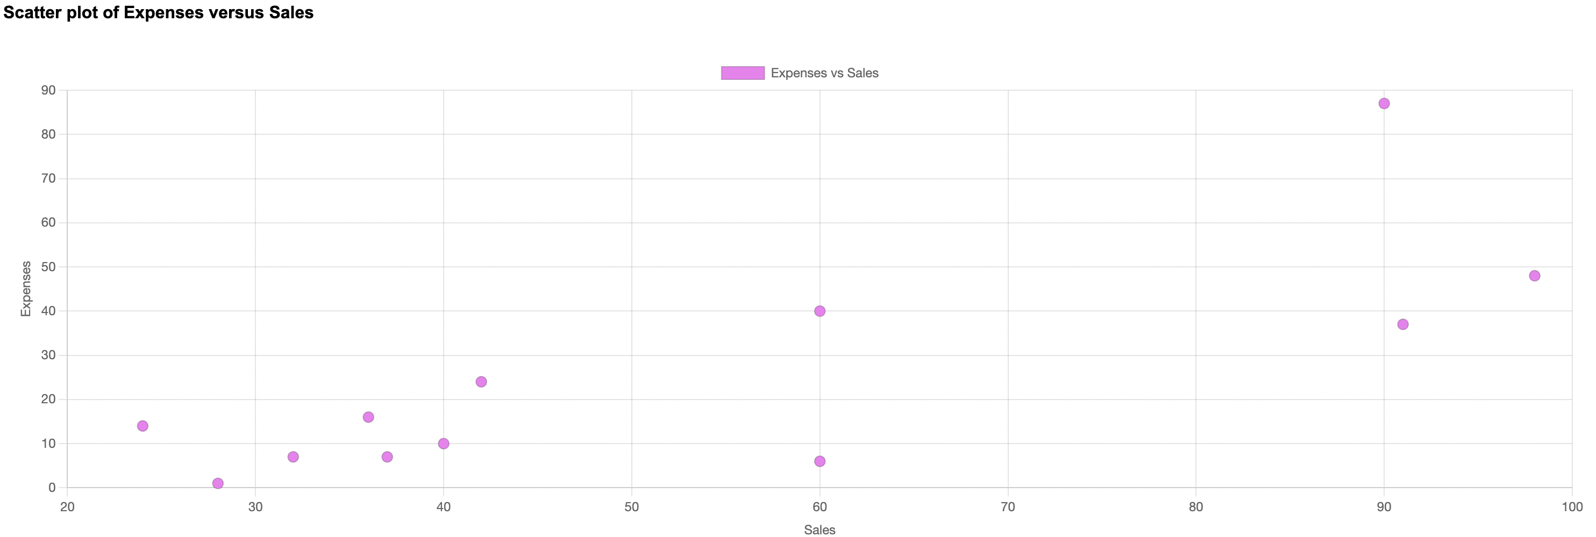
Demo of application – Scatter plot Expenses versus Sales

Slide 11
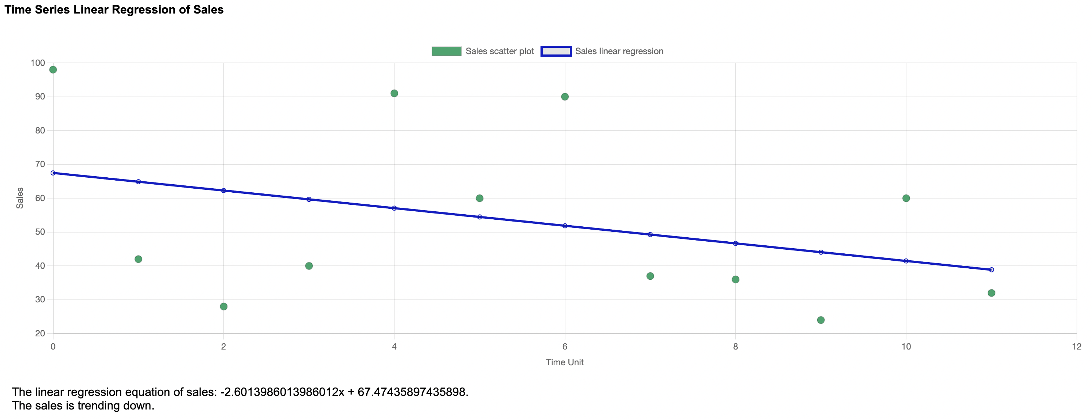
Demo of application – Regression Analysis of Time Series (Sales)

Slide 12
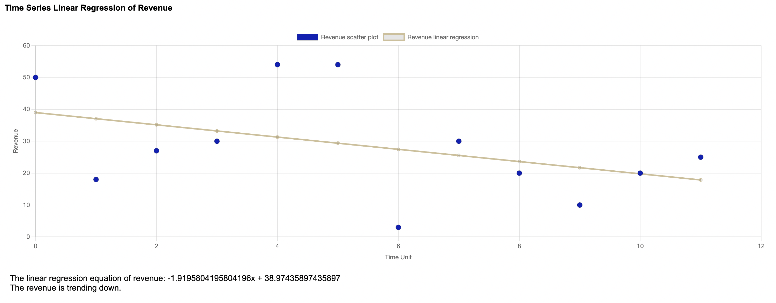
Demo of application – Regression Analysis of Time Series (Revenue)

Slide 13
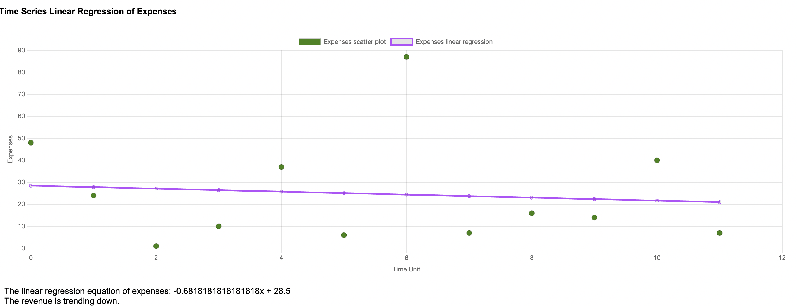
Demo of application – Regression Analysis of Time Series (Revenue)

Slide 14
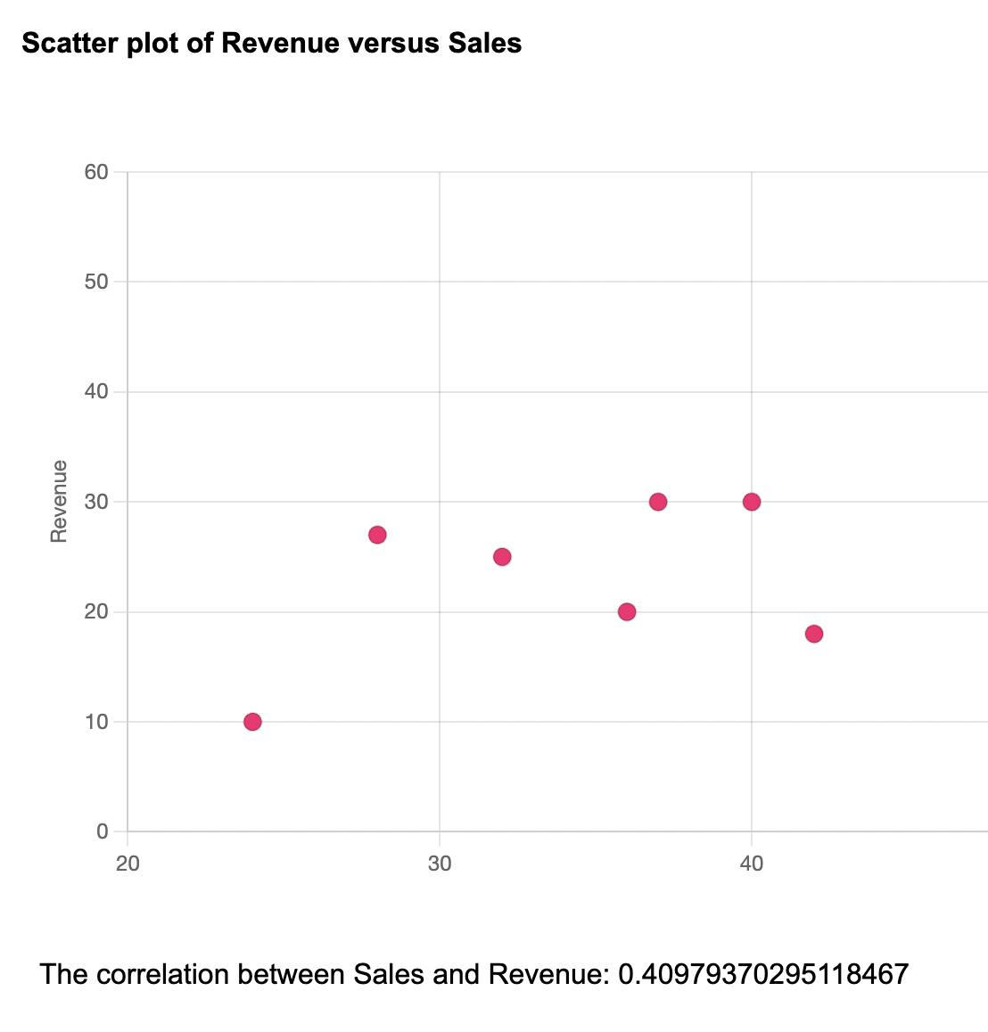
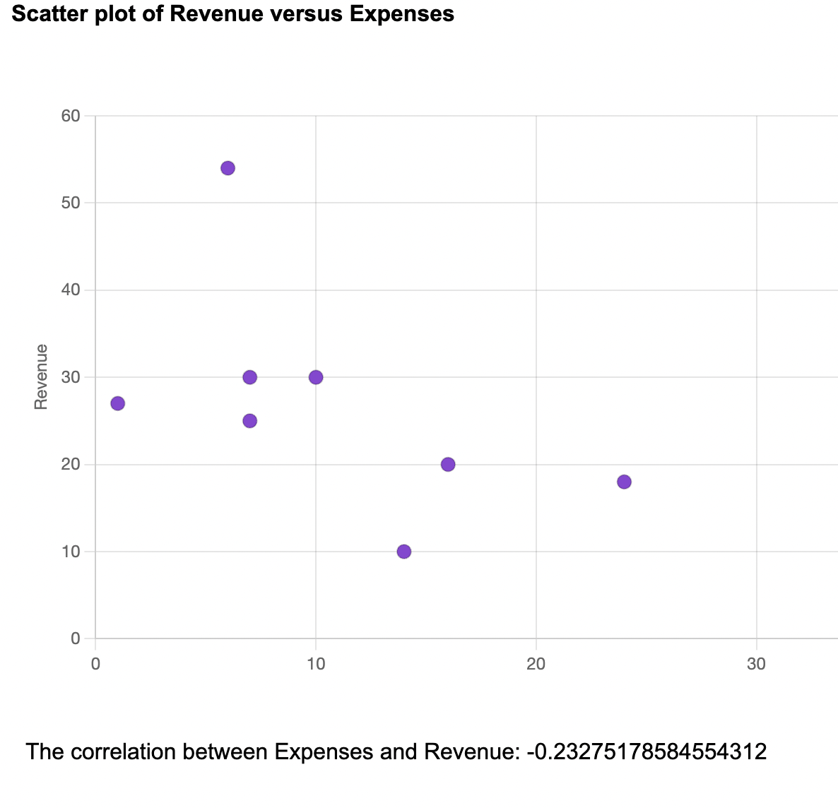
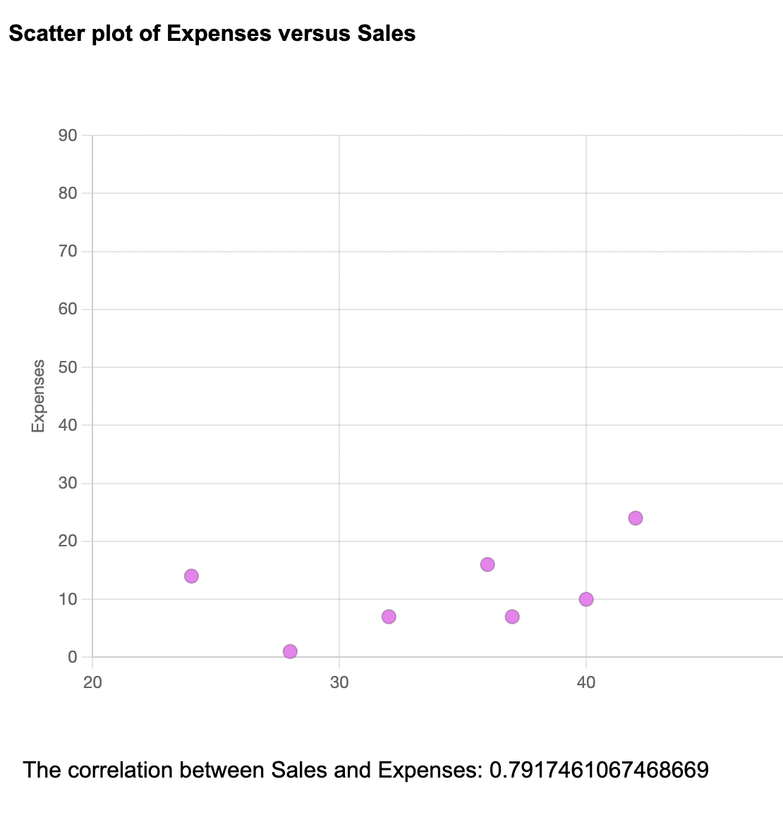
Demo of application – correlation under scatter plot

Slide 15
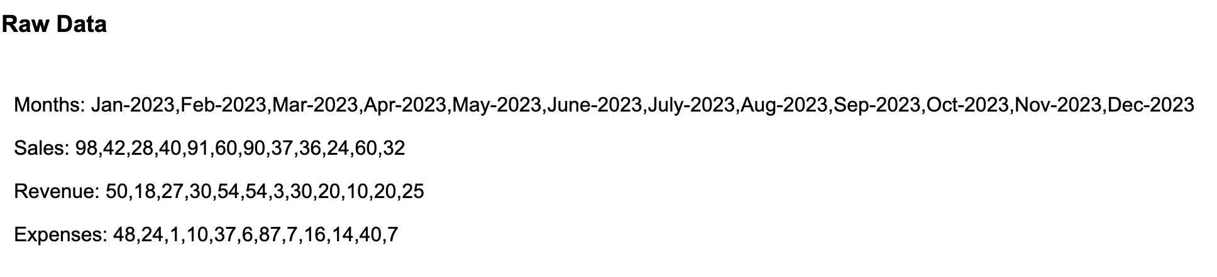
Demo of application – RAW DATA

